Slide 1

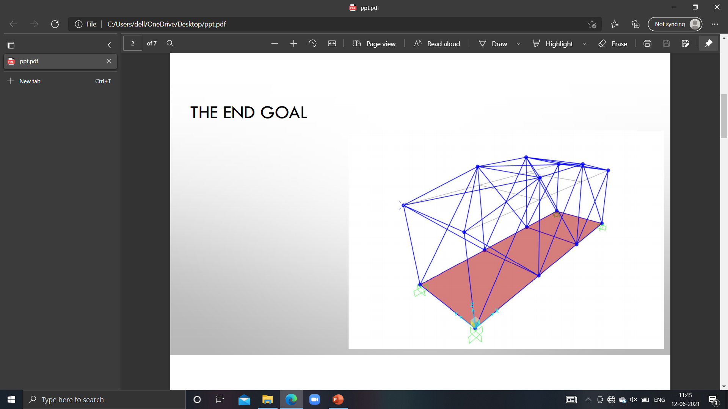
DESCON SOCIETY
ASSIGNMENT 1
PRESENTATION
STRUCTURE SUPER COMBO PART-1

Slide 2
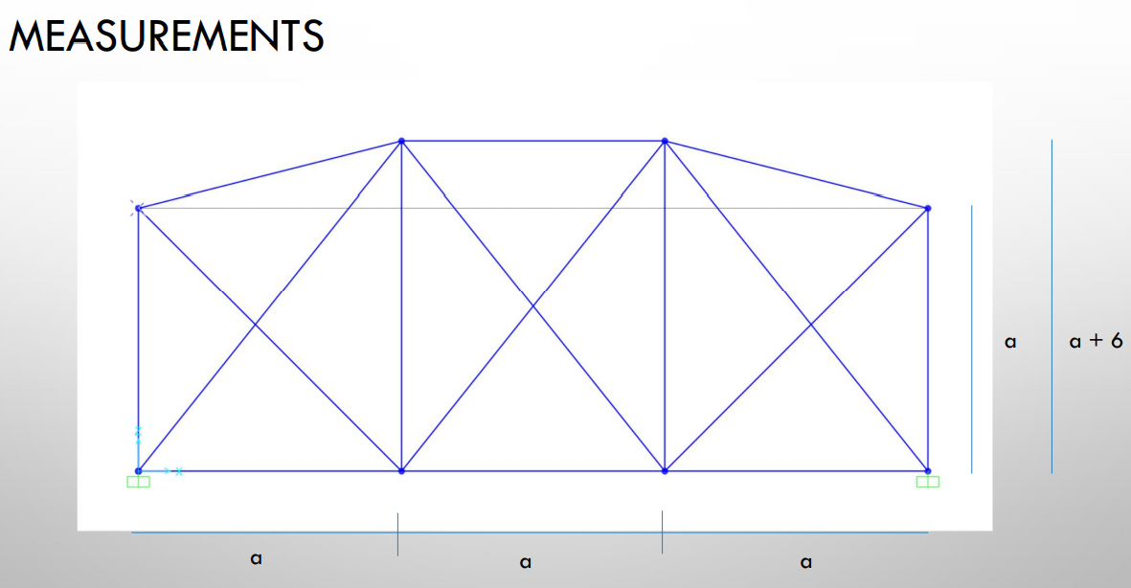
GIVEN MODEL :

Slide 3
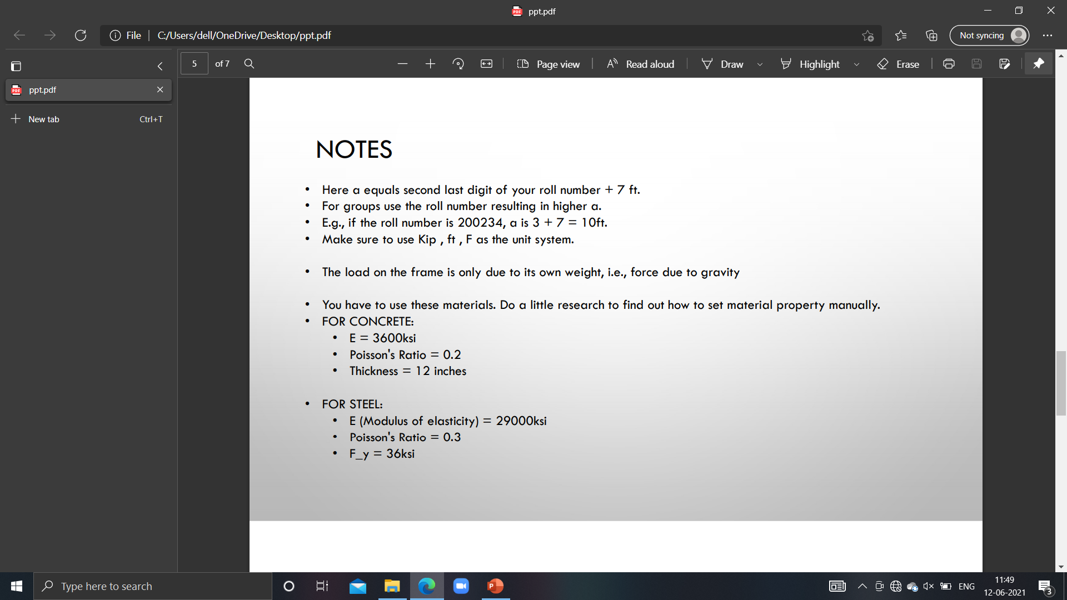
MATERIALS AND DIMENSIONS USED →
Value of a = 9ft.
(roll no =200728→2+7=9)

Slide 4
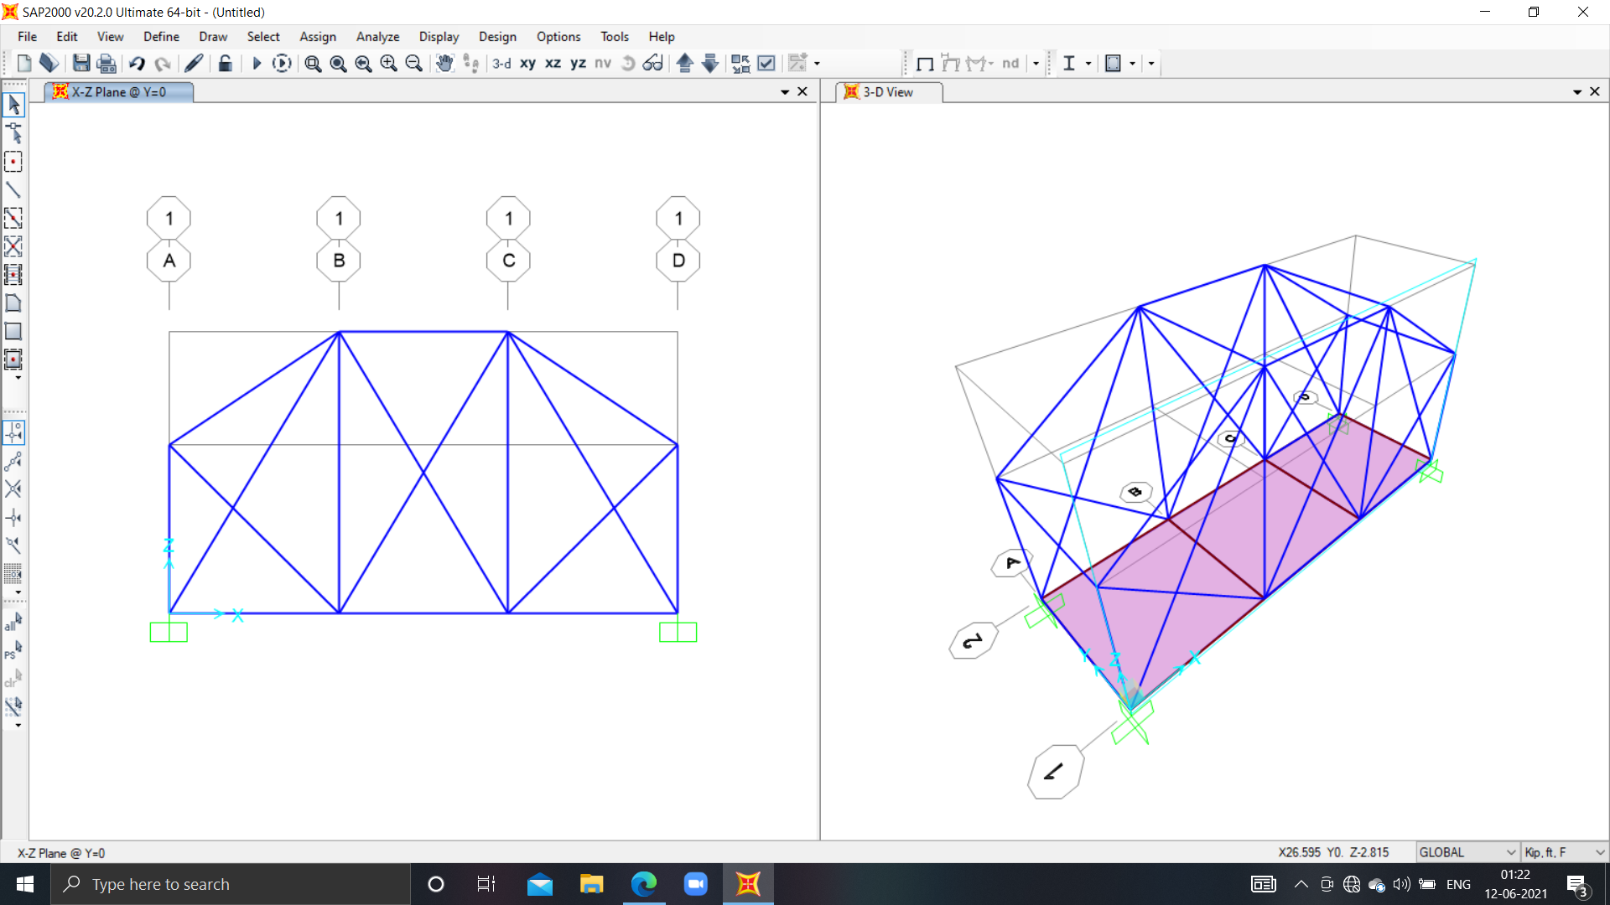
PICTURE OF UNDEFORMED STRUCTURE IN X-Z PLANE :

Slide 5
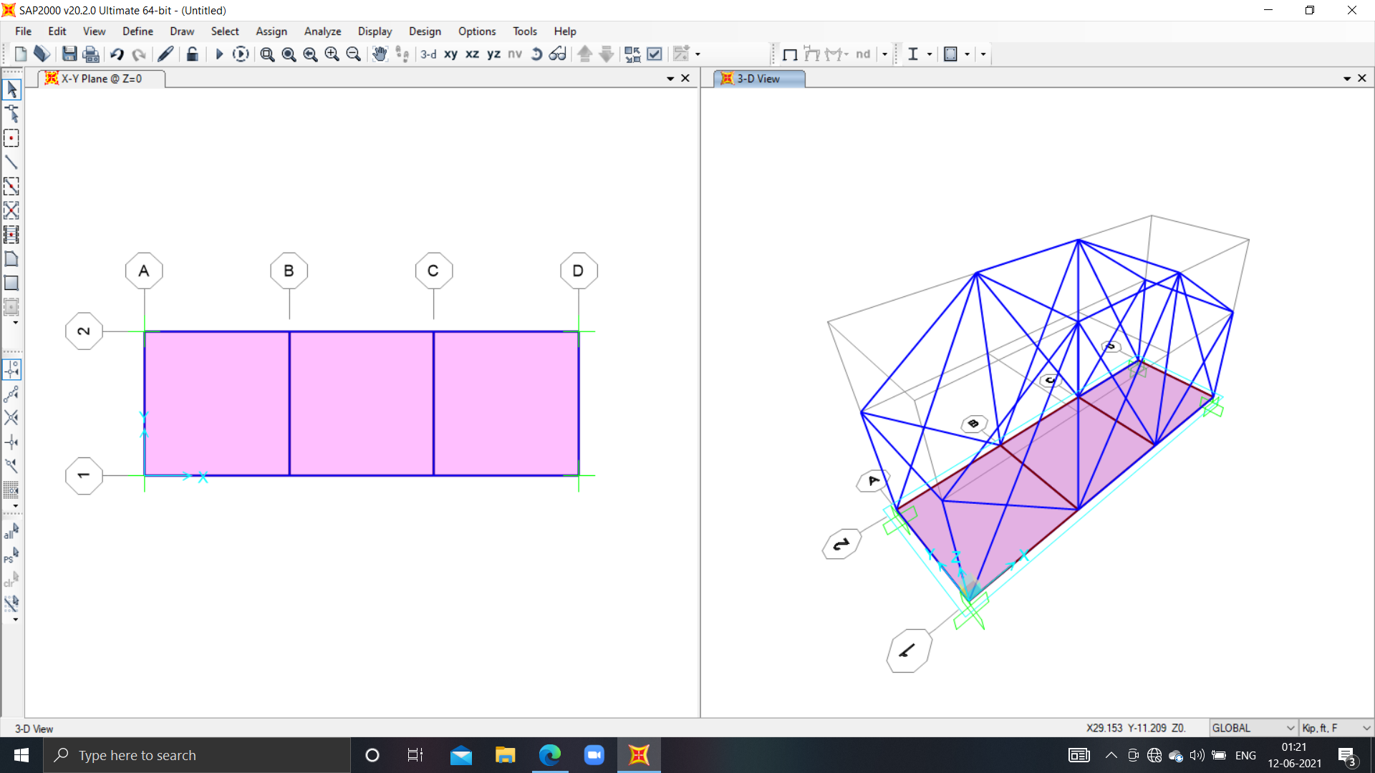
PICTURE OF UNDEFORMED STRUCTURE IN X-Y PLANE:

Slide 6
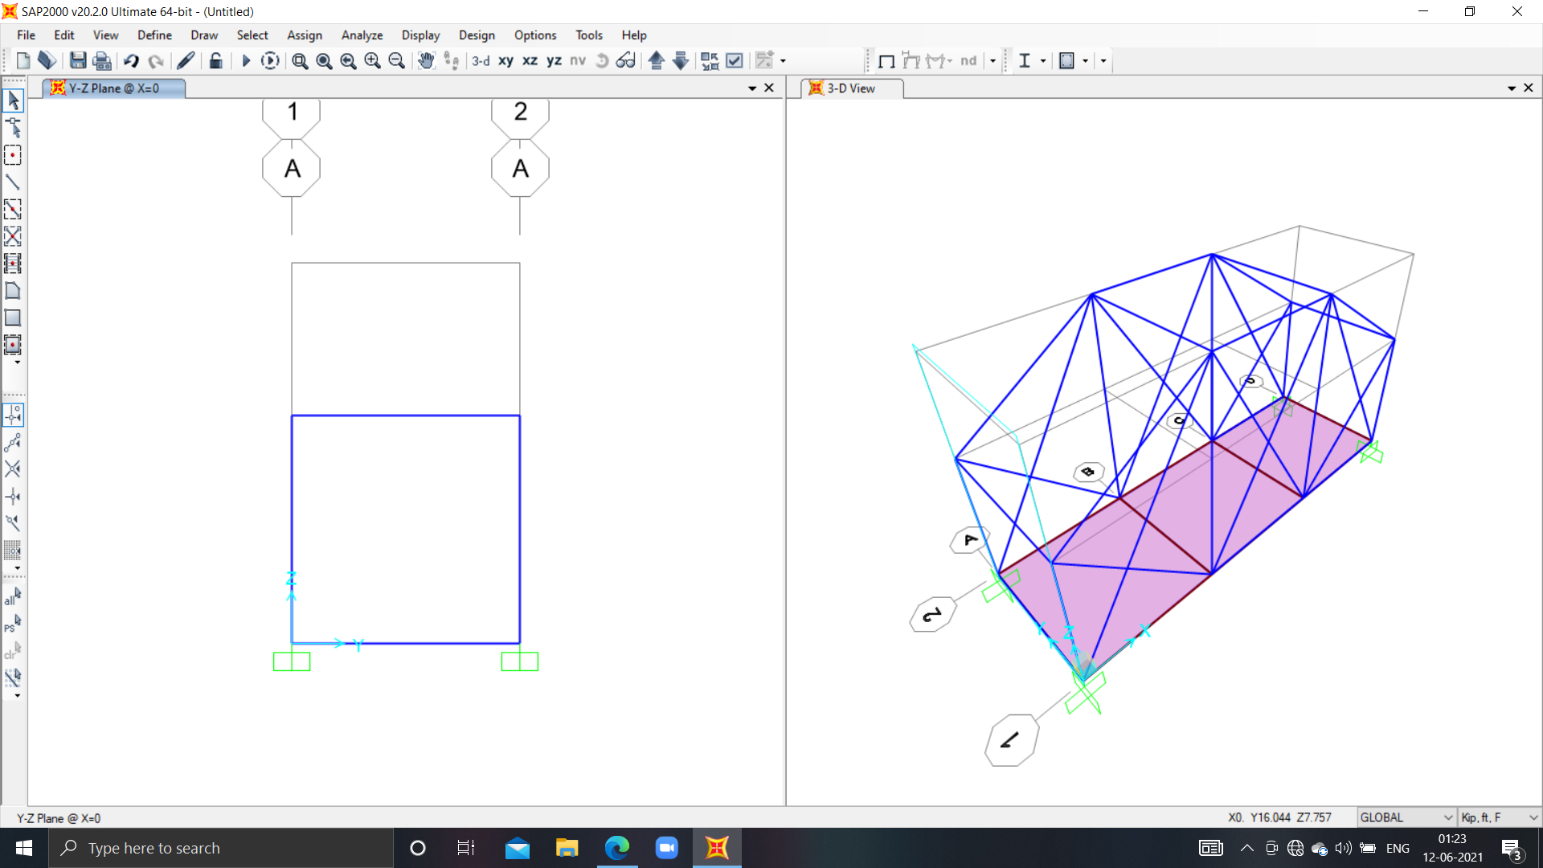
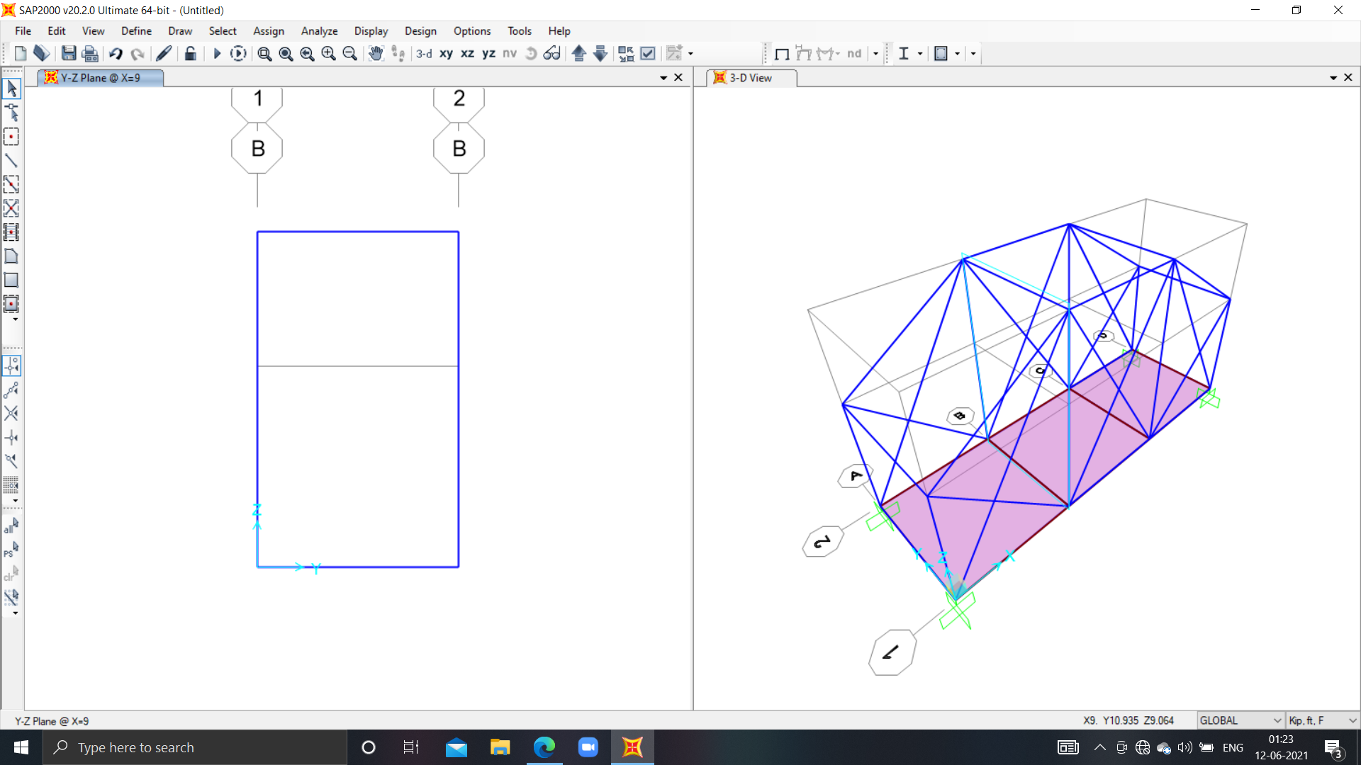
PICTURE OF UNDEFORMED STRUCTURE IN Y-Z PLANE :
X=0
X=9

Slide 7
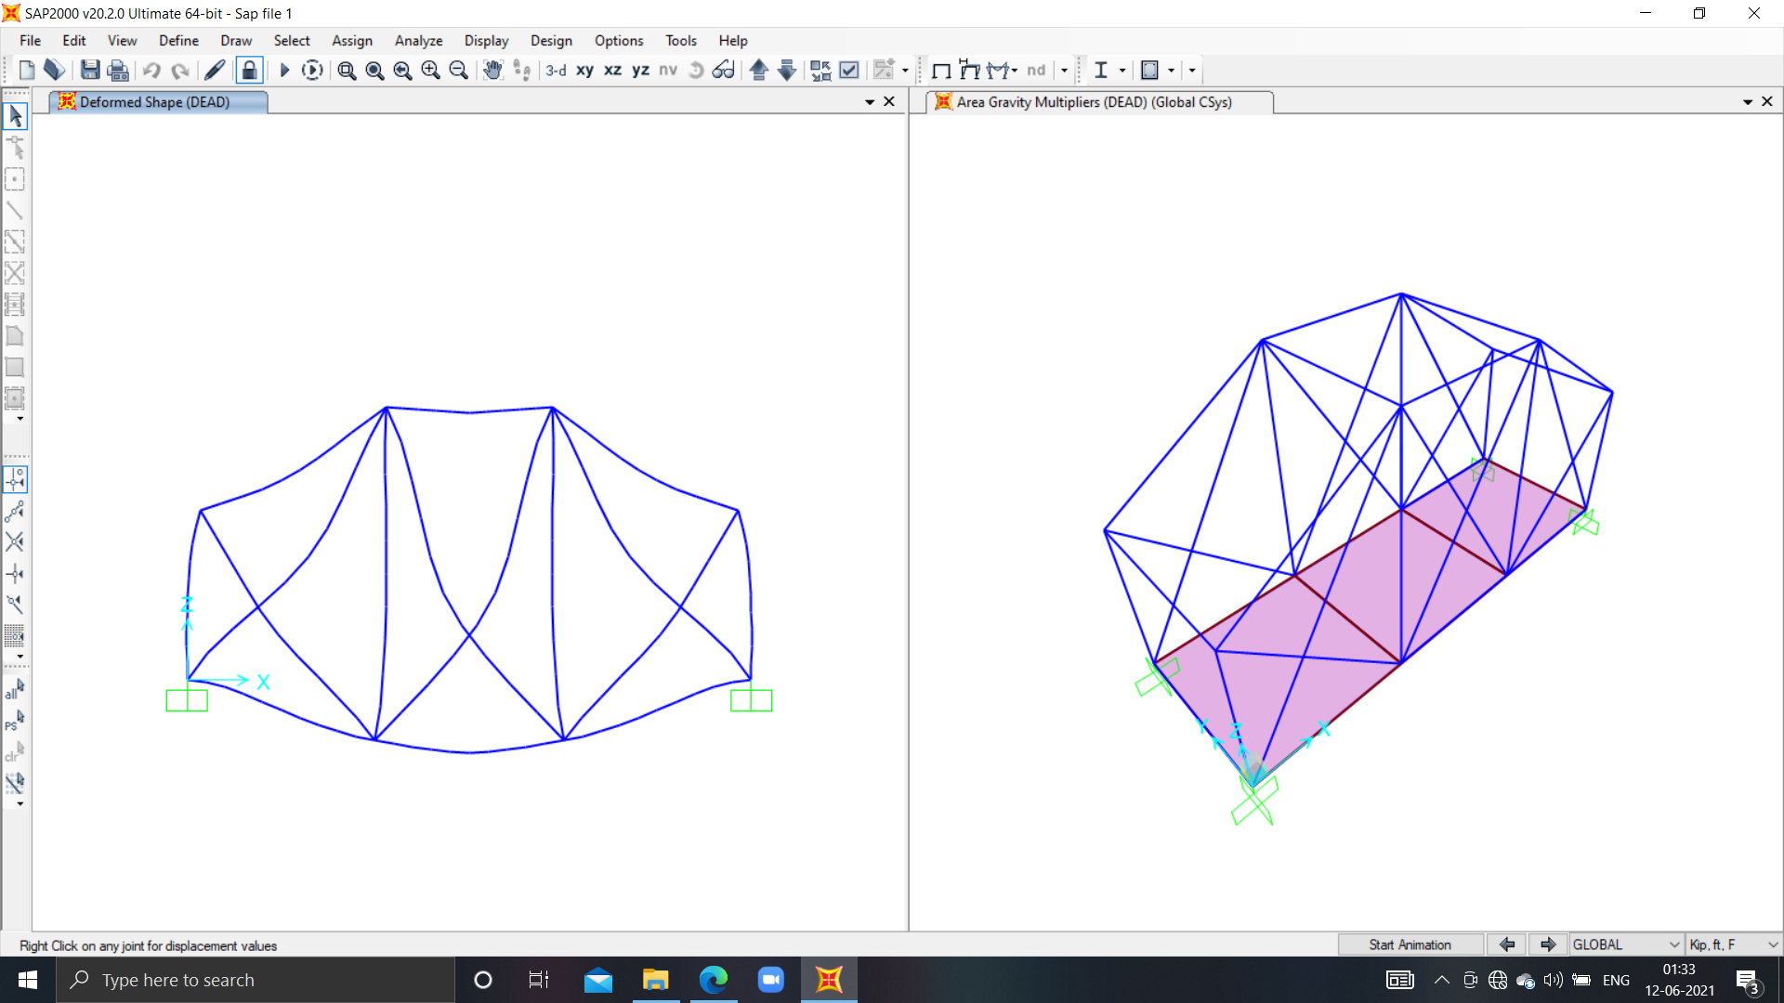
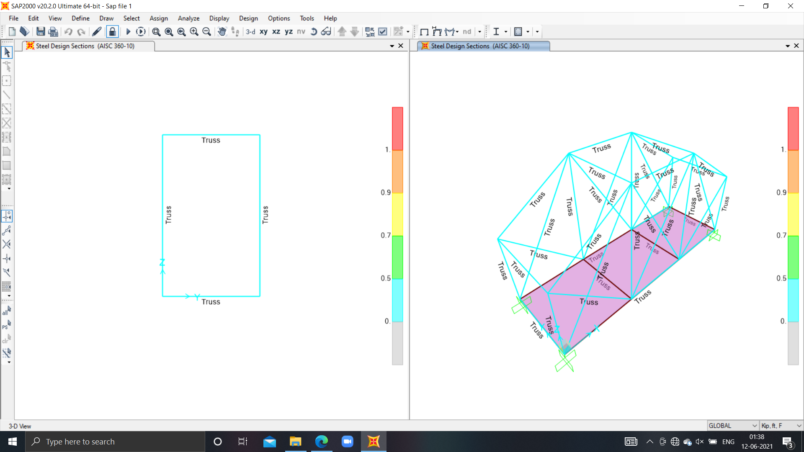
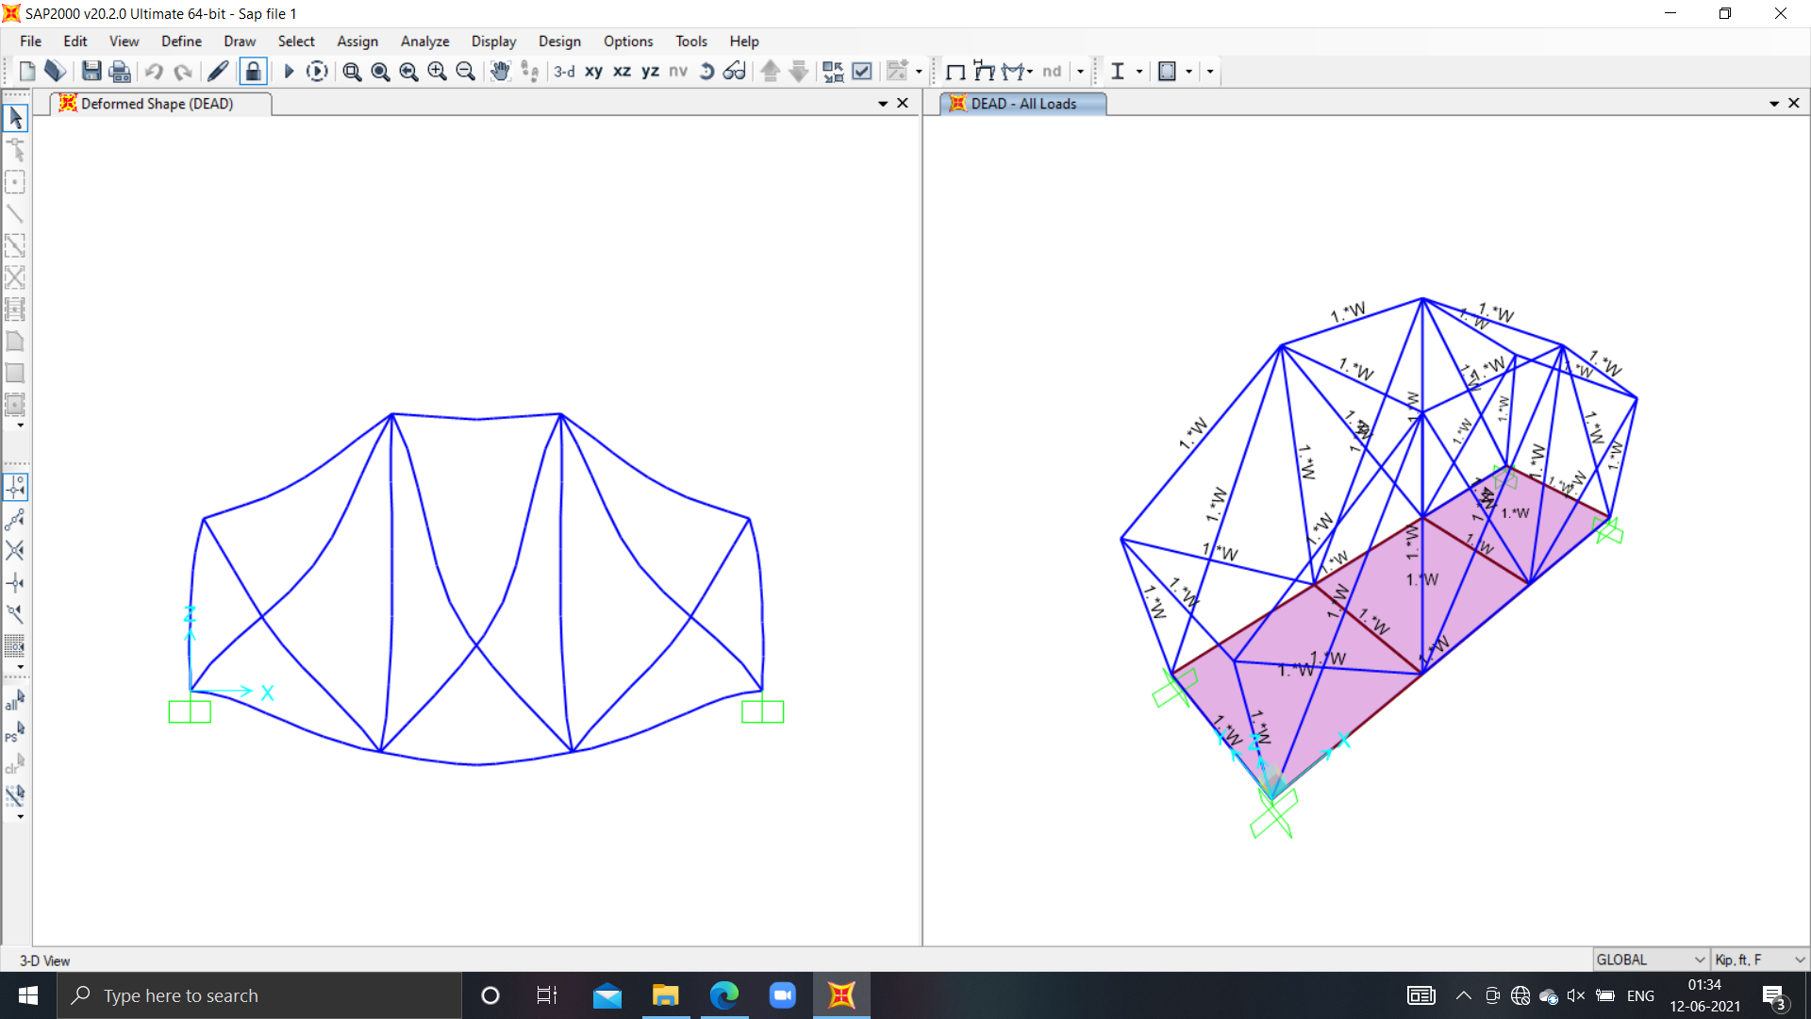
PICTURE OF UNDEFORMED STRUCTURE IN 3-D :

Slide 8
PICTURE OF DEFORMED STRUCTURE IN X-Z PLANE :

Slide 9
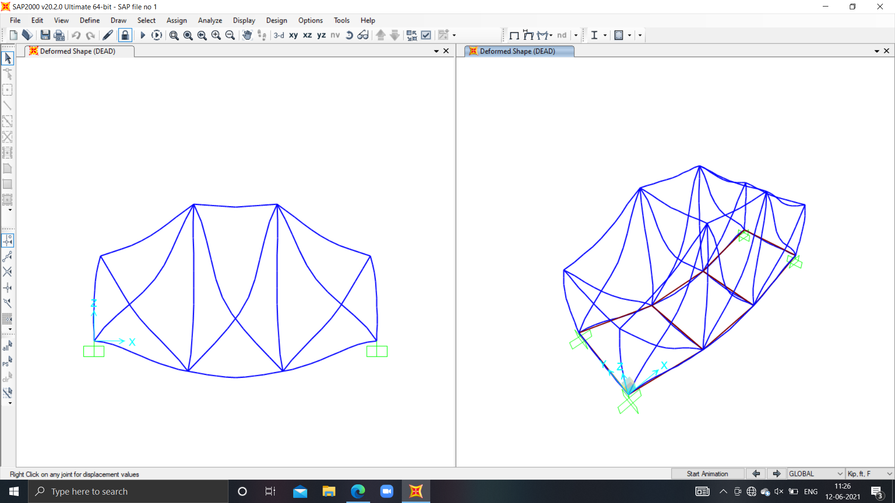
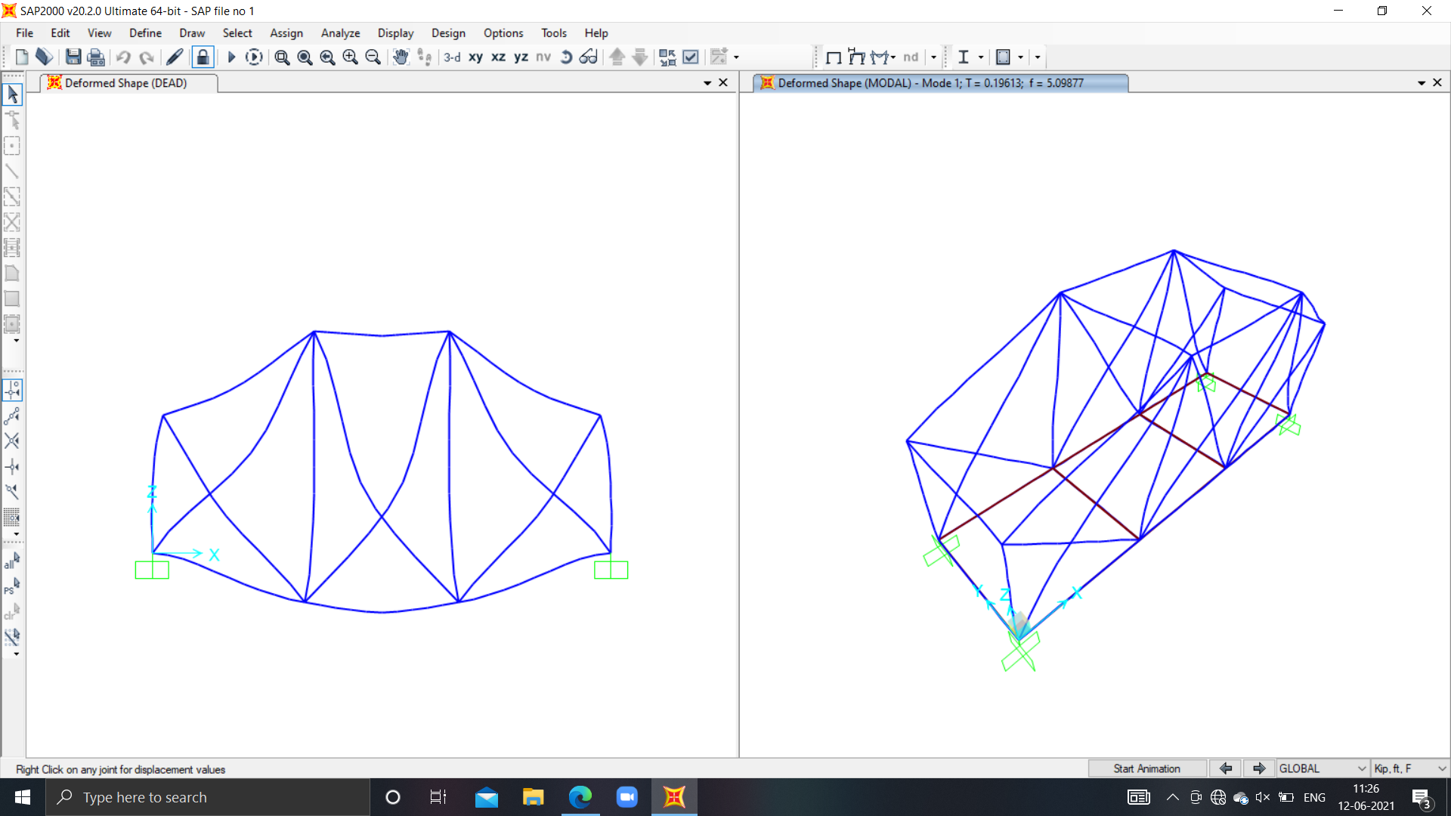
PICTURE OF DEFORMED STRUCTURE IN 3-D :

Slide 10
Thank You
By :PRIYA SINGH
Roll No. :200728

